Slide 1
Maria Houston
502 Organization and Access
Instructor Jan Nies
19 September 2021
Elementary
LS2 Kids and LS2 Pac
At Twin Ridge Elementary School students can use the LS2 Kids and LS2 Pac systems to access information in the library media center. I have enclosed two separate PowerPoint presentations. One demonstrating how to use LS2 Kids and the other demonstrating how to use LS2 Pac. The PowerPoint slides will be color printed, cut out, laminated, hole-punched, and assembled in a binder. The binders will be available by each Chromebook self-browsing station in Twin Ridge’s Elementary School library media center. I will also provide each classroom teacher with a binder. These resources will also be uploaded to the media center’s Schoology pages to support students at home in quarantine due to COVID-19.

Slide 2
LS2 Pac for elementary
“Mrs. Houston, do you have my favorite book in the library?”
“Mrs. Houston, my teacher wants me to do research. How do I find a book?”

Slide 3
Grab a Chromebook and log in.
Use your email: [username]@my.fcps.org and password: [unique for each student].
If you don’t know your username or password, then ask Mrs. Houston or your classroom teacher. We are here to help.

Slide 4
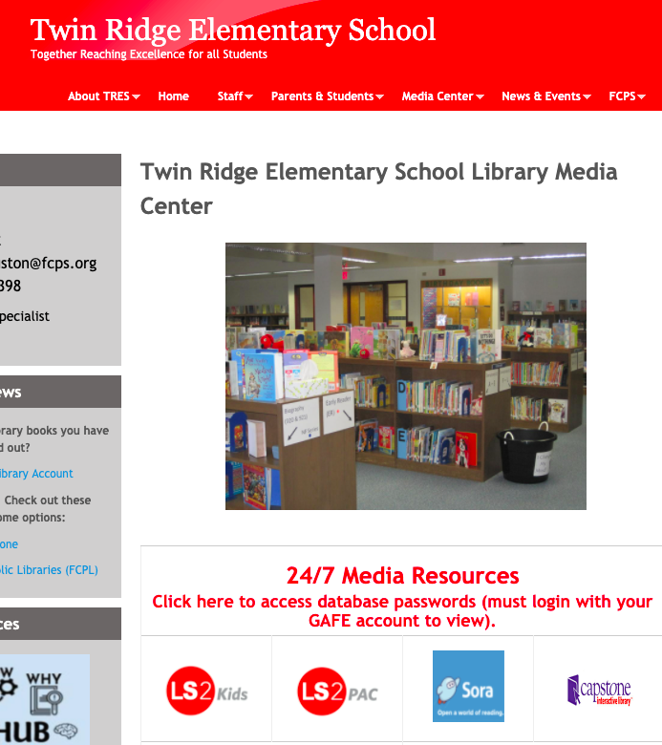
Go to our TRES Library Media Center website.
It is bookmarked on your account for you.
You can also access it here: education.fcps.org/tres/mediacenter

Slide 5
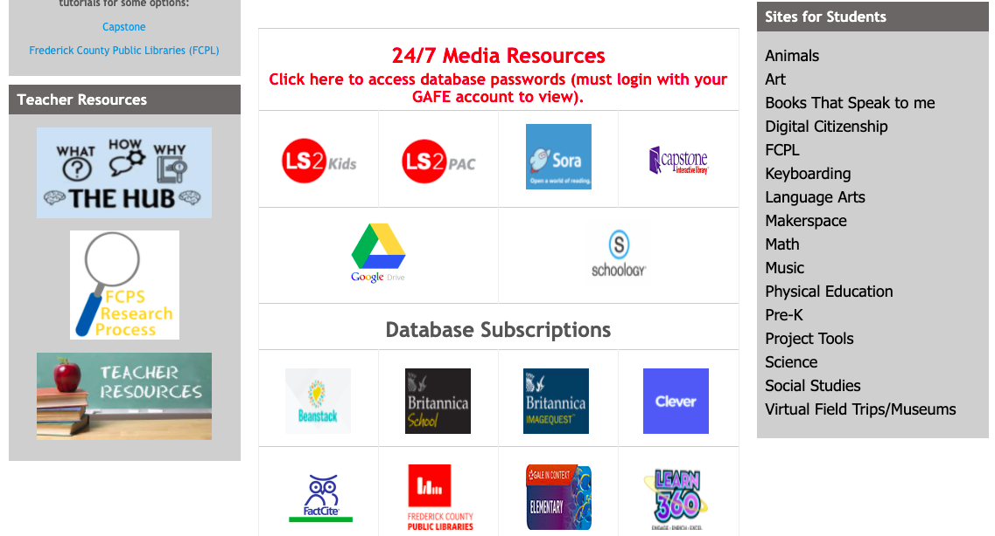
Find LS2 Pac on the website.
It looks like this:

Slide 6
This is the homepage.
Try this for more specific research
Use the search bar
Explore these tabs
You can explore the visual bookshelf

Slide 7
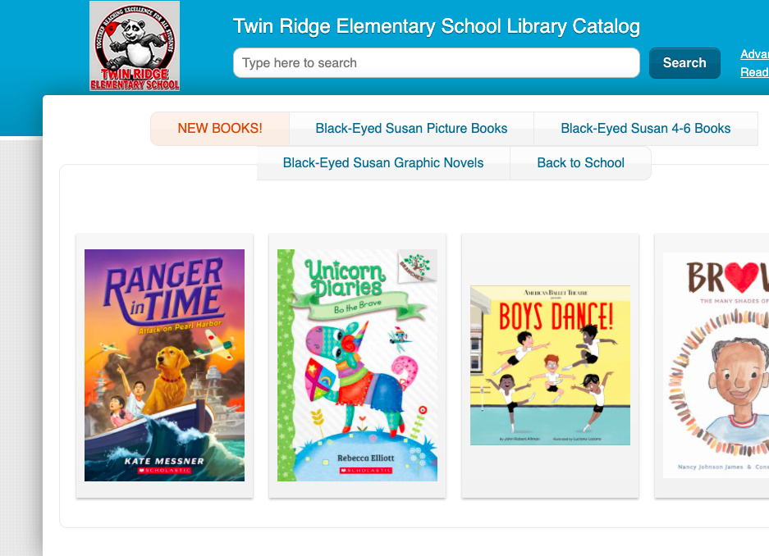
Keyword Search
search bar
Keyword searches are a great way to begin your research. Enter a word into the search bar. Try:
Biomes
Space
Citizenship
Continents
Weather
Climate
Communities
Geography

Slide 8
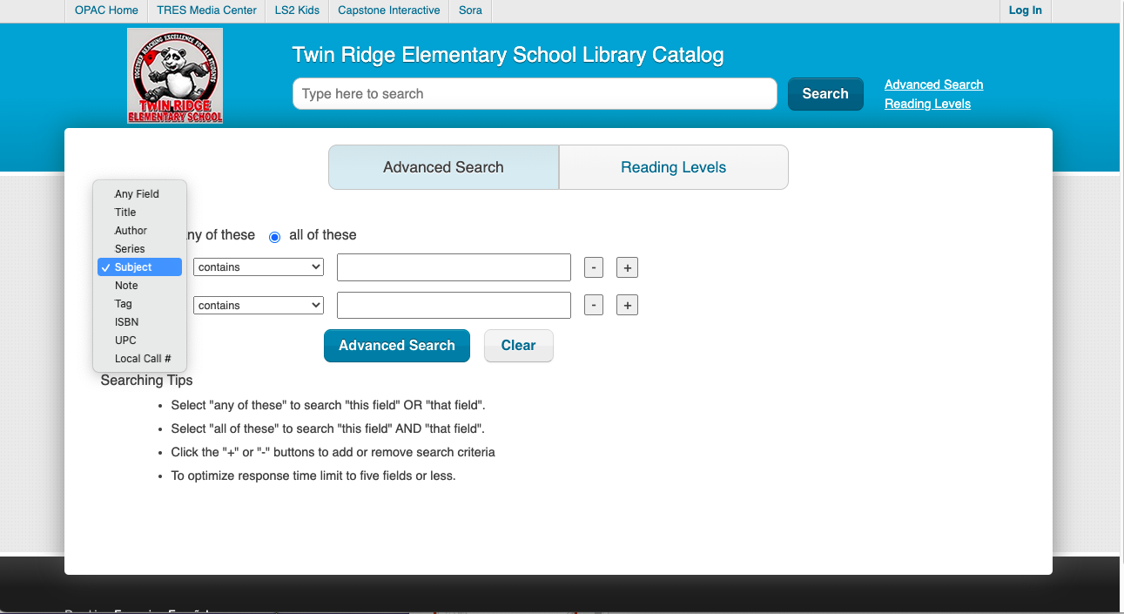
You might have too much information! Try a Subject Search.
A Subject Search only uses the terms from the Library of Congress Subject Headings to populate your search results.
You should get less results, but they should be more specific. Try it!
Go to Advanced Search
Change the toggle button to Subject.
Type in a subject you want to research...

Slide 9
Try these Library of Congress Subject Headings instead of using a keyword search term:
LSCH heading to use
Planets
Rain forests
Maps
Deserts
Magnets
Oceanography-- Juvenile Literature
Tundras
Astronomy

Slide 10
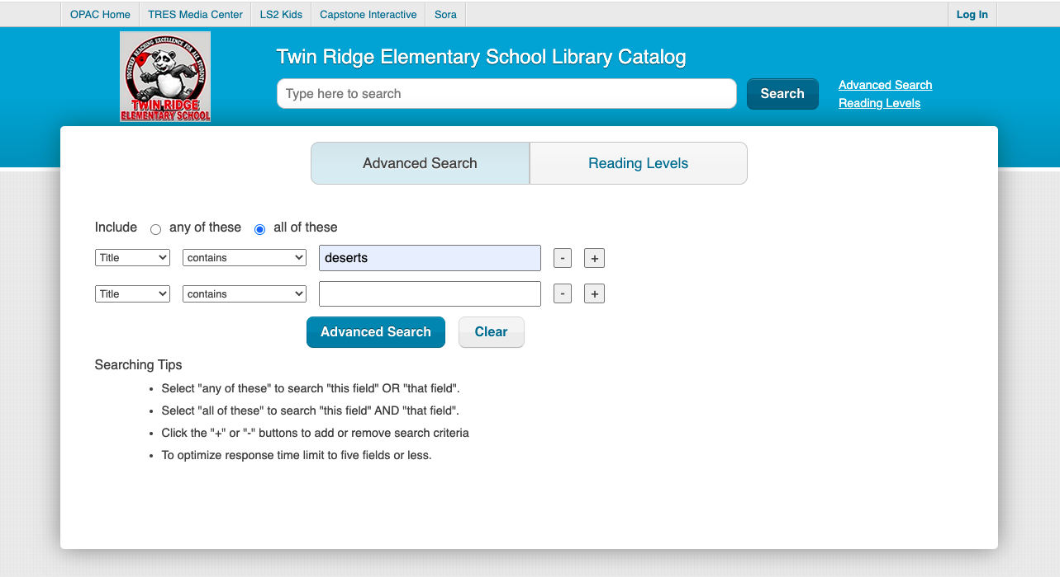
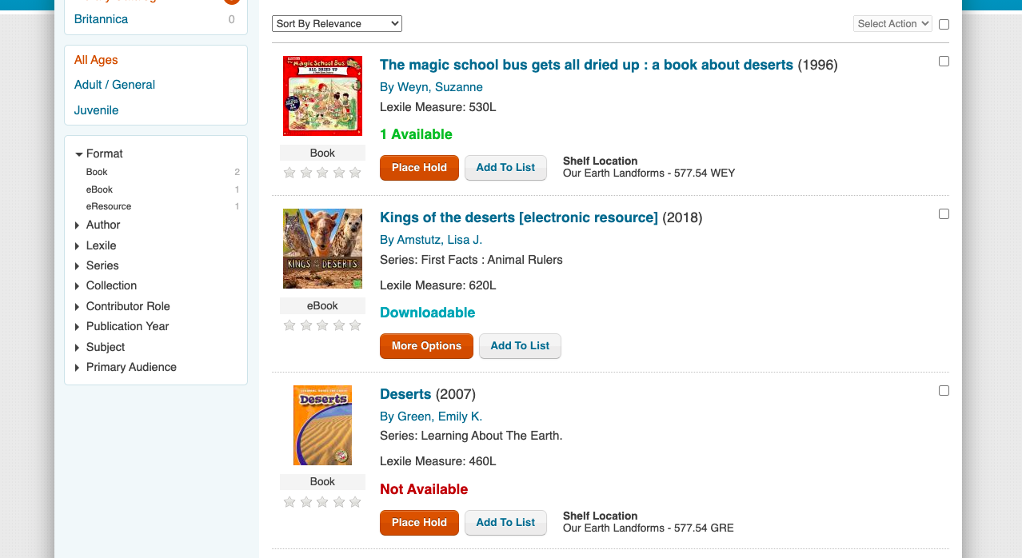
Other important information you should know!
Try a title search. Switch this to title.
This tells the computer to look for book titles with your specific word in it.
These are the books in our library with the word “deserts” in the title.
Tip: This is a great way to know if we have a specific book you want in the library.

Slide 11
Let Mrs. Houston know if you need any help using LS2 Pac. I am here to help you!

Slide 12
Works Cited
All book images are from LS2 Pac. LS2Pac, The Library Corporation, 2020.
All screenshots are from LS2 Pac. LS2Pac, The Library Corporation, 2020.
Bitmoji Images. Bitmoji. Snap Inc, 2020, www.bitmoji.com. Accessed 19 September 2021.
“Keyword vs subject searching.” Oregon Institute of Technology, 2021,
www.oit.edu/library/help/library-guides/keyword-vs-subject. Accessed 19 September 2021.
Levine, Julia. FCPS Collection Images. Accessed 19 September 2021.
Levine, Julia. Twin Ridge Shelf Tags,
//docs.google.com/document/d/1NHg_HF7eNVnd1naGWZpDWRFq4cq0JXgoExX8 OdjlIZY/edit. Accessed 19 September 2021.
“Library of Congress Authorities.” The Library of Congress,
//authorities.loc.gov/cgi-bin/Pwebrecon.cgi?DB=local&PAGE=First. Accessed 19 September 2021.

