Slide 1
Maria Houston
502 Organization and Access
Instructor Jan Nies
19 September 2021
Elementary
LS2 Kids and LS2 Pac
At Twin Ridge Elementary School students can use the LS2 Kids and LS2 Pac systems to access information in the library media center. I have enclosed two separate PowerPoint presentations. One demonstrating how to use LS2 Kids and the other demonstrating how to use LS2 Pac. The PowerPoint slides will be color printed, cut out, laminated, hole-punched, and assembled in a binder. The binders will be available by each Chromebook self-browsing station in Twin Ridge’s Elementary School library media center. I will also provide each classroom teacher with a binder. These resources will also be uploaded to the media center’s Schoology pages to support students at home in quarantine due to COVID-19.

Slide 2
Learn how to use the OPAC system so you can answer this question yourself.
”Mrs. Houston, do you have…?”

Slide 3
1st
Grab a Chromebook and log in.
Use your email: [username]@my.fcps.org and password: [unique for each student].
If you don’t know your username or password, then ask Mrs. Houston or your classroom teacher. We are here to help.

Slide 4
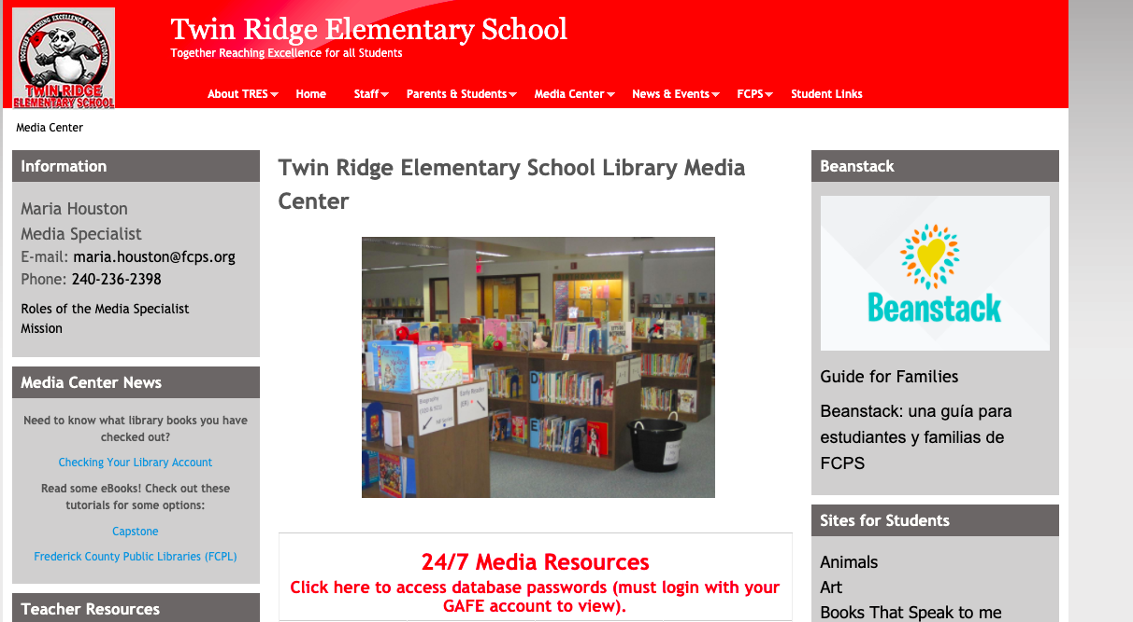
2nd
Go to the Twin Ridge Elementary Library Media Center website. It is bookmarked on your account for you. You can also access it here: education.fcps.org/tres/mediacenter

Slide 5
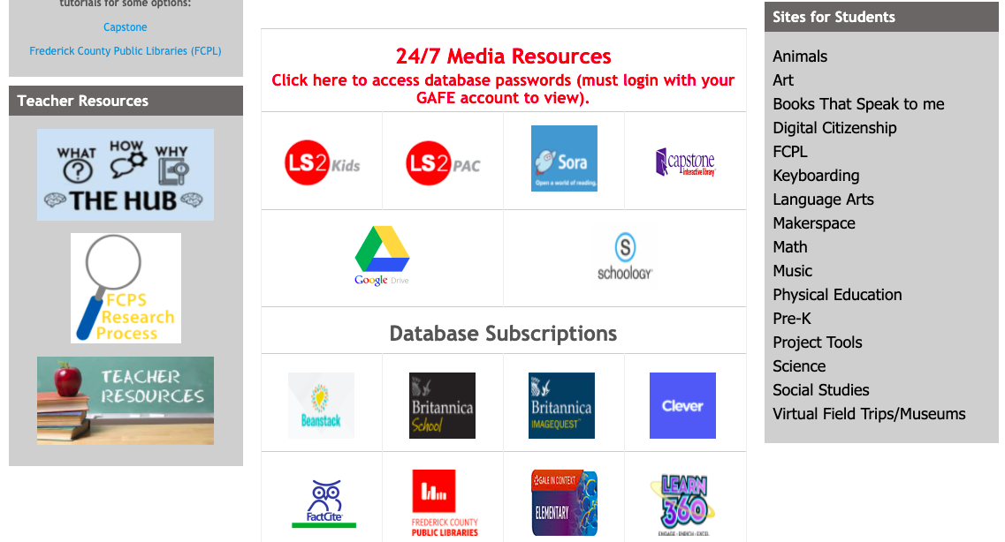
3rd
Find the LS2 Kids on the website. It looks like this:

Slide 6
4th
You can look for a book in many ways:
You can use the search bar.
Explore Categories by clicking on a picture.
Explore Series & Chapter Books by clicking on this section.

Slide 7
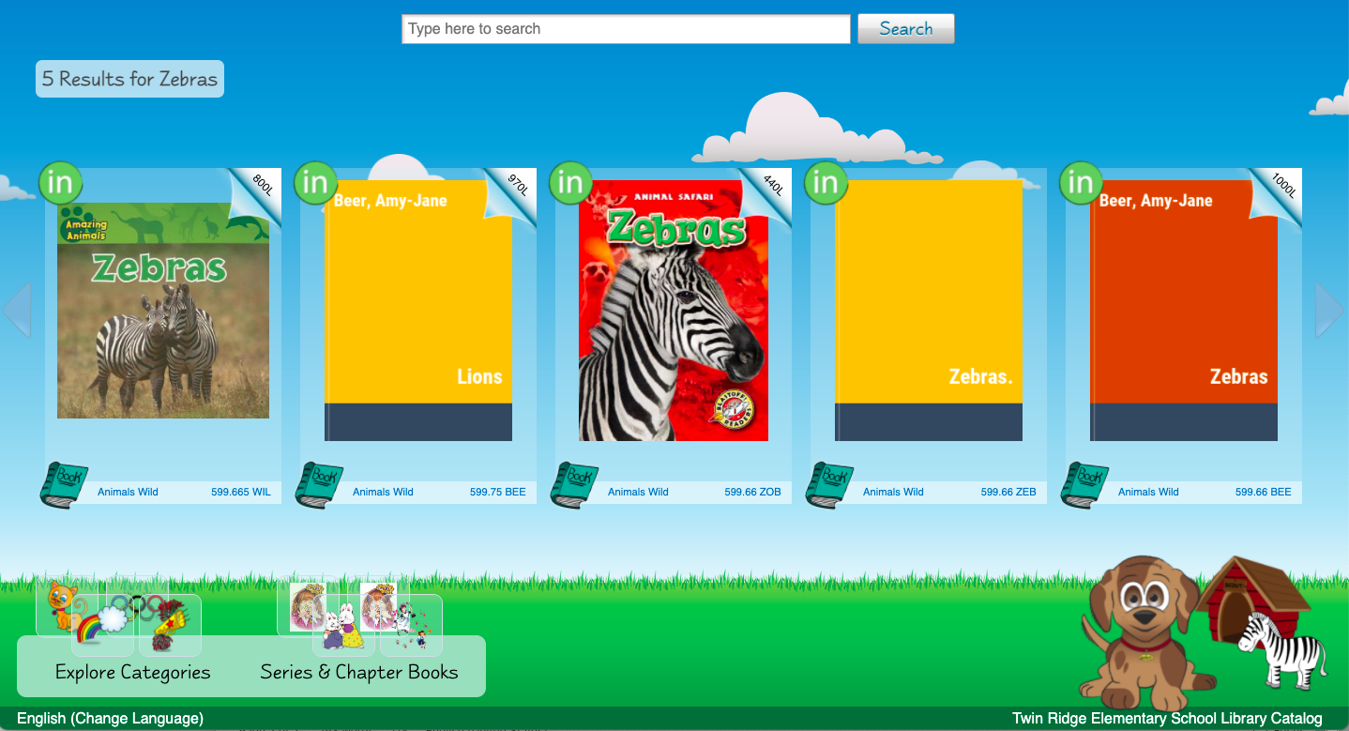
5th
Explore Categories by using a Subject Search:
You might want to learn about zebras. Click on the picture of a zebra.
Then you will see the books we have on zebras.

Slide 8
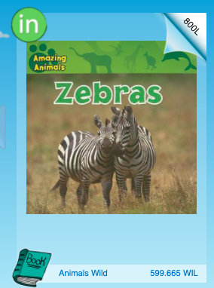
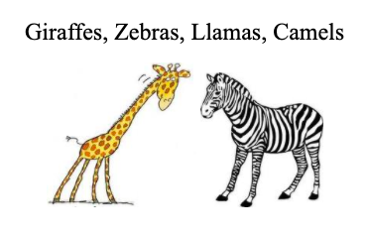
6th
This means the book is in our library.
Look for the Animal Paws
bookshelf:
It’s on the Animals bookshelf.
Look for this shelf tag:

Slide 9
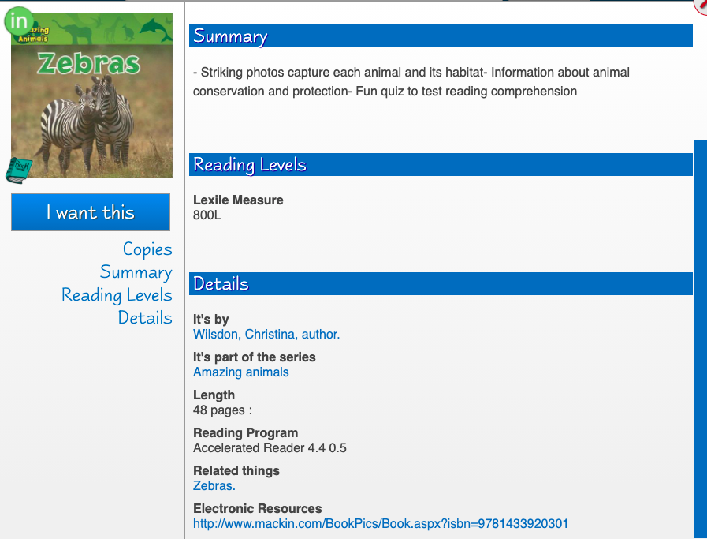
7th
Library of Congress Search Headings

Slide 10
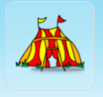
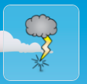
Explore more TRES books
LS2 Kids Pictures
LCSH
Monsters
Circus
Fire engines
Pirates-- History
LS2 Kids Pictures
LCSH
Thunderstorms
Fishing
Martial arts
Skateboarding

Slide 11
8th
How do I use keywords in the search bar?
Type in:
Author’s name (i.e. Mo Willems)
Book title (i.e. If You Give a Mouse a Cookie)
Subject (i.e. dogs, baseball, plants)

Slide 12
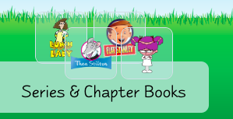
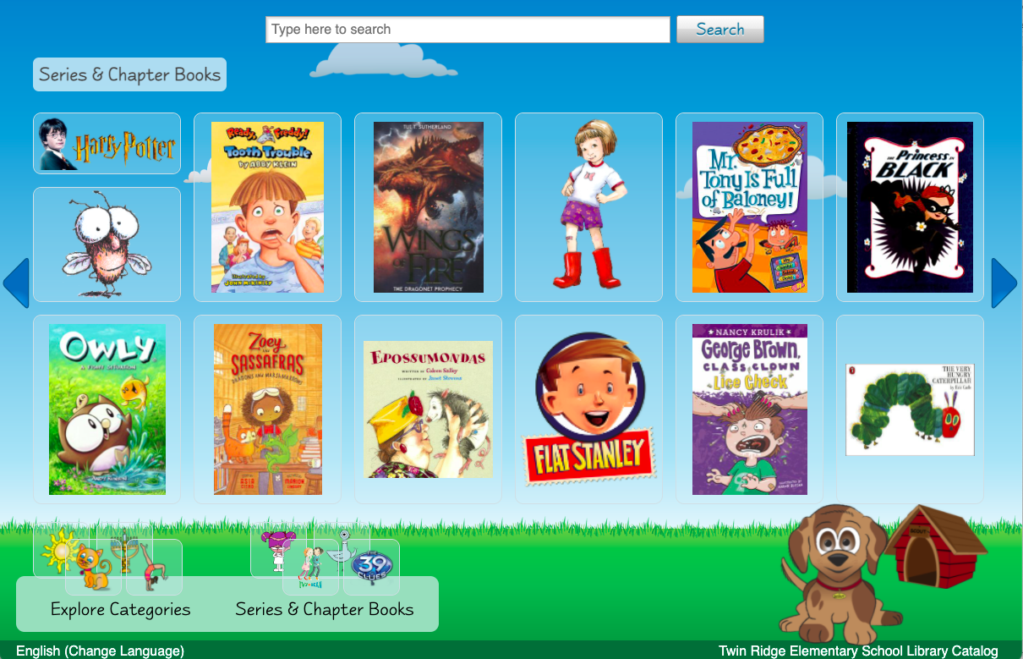
9th
How do I use the Series & Chapter Books webpage?
Click on this at the bottom of the webpage.
Look for your favorite book and find other similar books.

Slide 13
10th
You did it!
Ask Mrs. Houston if you have any questions!

Slide 14
Works Cited
All book images are from LS2 Kids. LS2Kids, The Library Corporation, 2020.
All screenshots are from LS2 Kids. LS2Kids, The Library Corporation, 2020.
Bitmoji Images. Bitmoji. Snap Inc, 2020, www.bitmoji.com. Accessed 19 September 2021.
“Keyword vs subject searching.” Oregon Institute of Technology, 2021,
www.oit.edu/library/help/library-guides/keyword-vs-subject. Accessed
19 September 2021.
Levine, Julia. FCPS Collection Images. Accessed 19 September 2021.
Levine, Julia. Twin Ridge Shelf Tags,
//docs.google.com/document/d/1NHg_HF7eNVnd1naGWZpDWRFq4cq0JXgoExX8OdjlIZY/edit. Accessed 19 September 2021.
“Library of Congress Authorities.” The Library of Congress, //authorities.loc.gov/cgi-
bin/Pwebrecon.cgi?DB=local&PAGE=First.
Accessed 19 September 2021.

